Slide 1

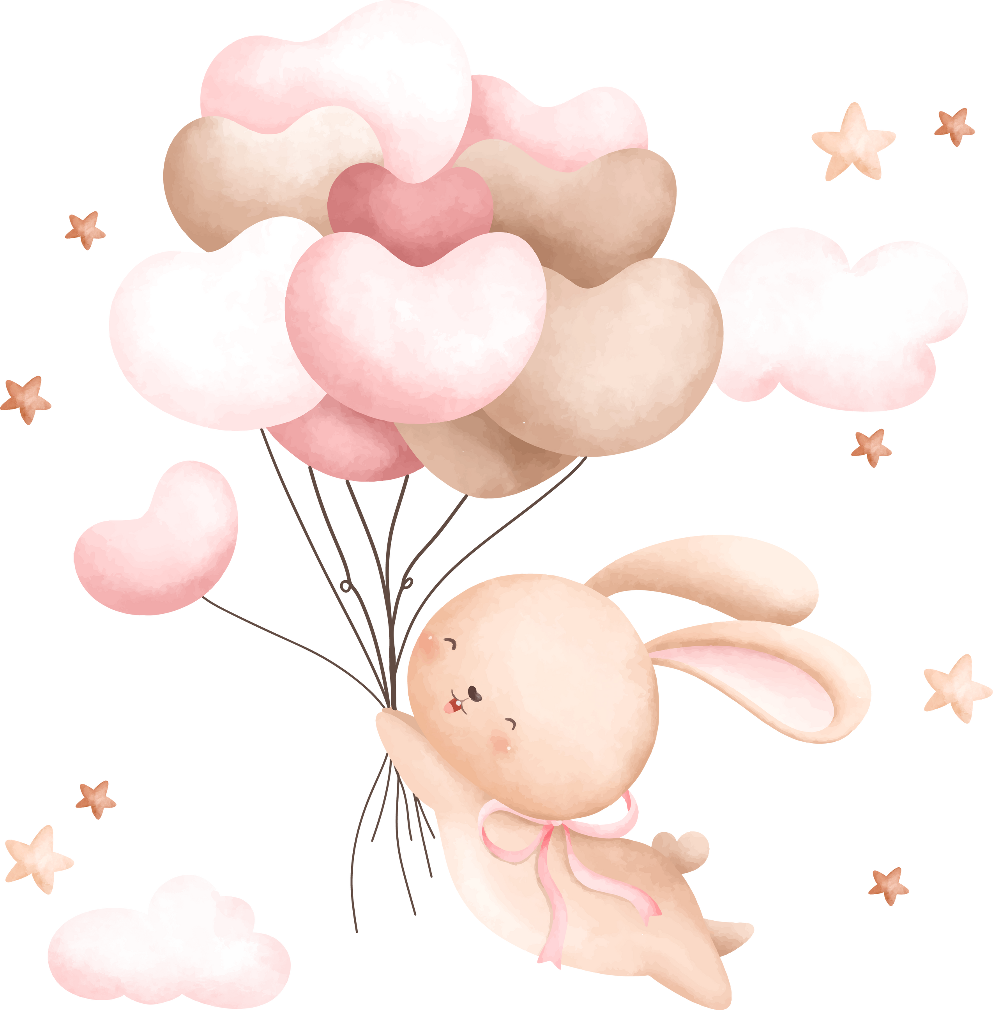
WELCOME
BABY
It's a girl!

